Slide 1
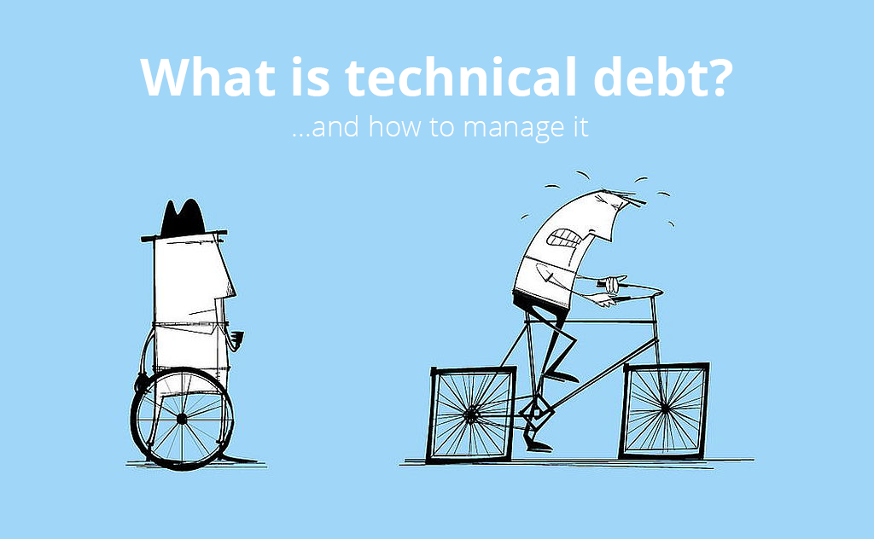
What is technical debt?

Slide 2
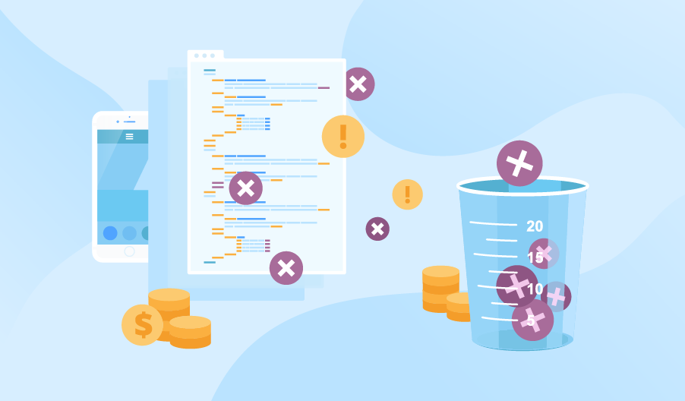
How it is measured?

Slide 3
How to reduce Technical Debt?
Simple Architecture (Passes the tests, Reveals Intention, No Duplication, Fewest Elements)
Continuous Refactoring
Good Unit Tests
TDD
Static Analysis
Good Standards
Peer Reviews
Fingers crossed (Nobody can predict future architecture and when current architecture becomes obselete)
Maintain a Technical Backlog
Do a cleanup spring once in a while!

Slide 4
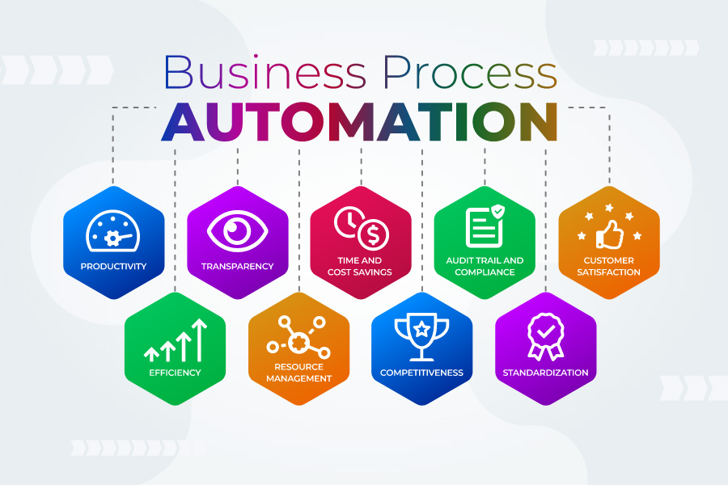

Slide 5
Best Practices to Automate Business Processes
Identify areas in need of functional improvement.
Find repetitive tasks.
Prioritize areas to automate.
Create a holistic plan.
Establish clear roles.
Create Standard operating procedures (SOPs).
Train users.
Create a backup plan.

